Slide 1
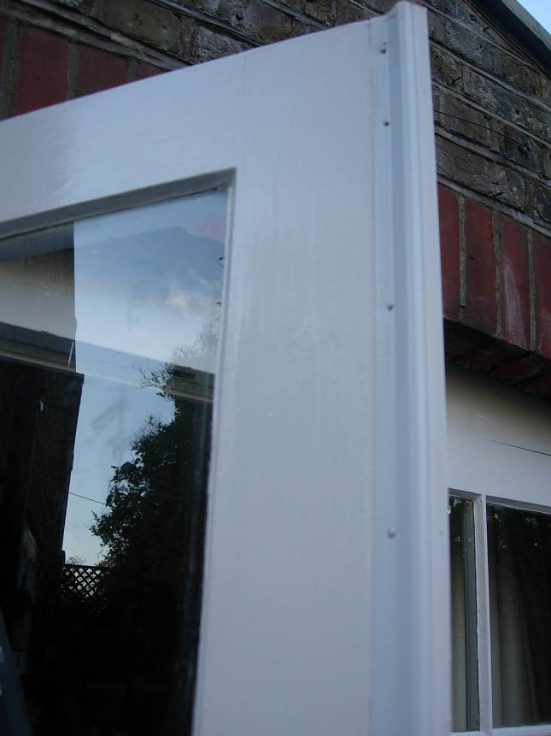
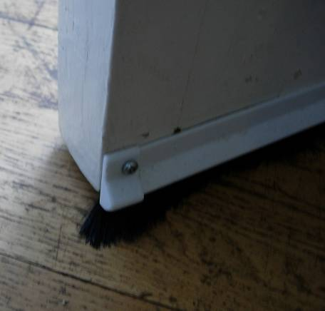
Energy Savers
DIY Draught Busting and Secondary Glazing.
Warm your home, cool your bills
A guide to draught proofing your home
Thanks to Hyde Farm CAN for providing the original draught proofing workshops, product research & documentation-and to Transition Belsize for sharing information about their draught busting project.
Thanks also to the Ashburton Futures project who developed the DIY secondary glazing guide that has been incorporated into this manual.

Slide 2
Table of Contents
General Advice 3-4
Product information and tools 5
Sash Windows Retro B strip 6
Sash meeting rails and French doors FS strip 7
Outside doors 21B strip 8
Installation instructions 9-10
Measuring your doors and windows 11-12
Letter box brushes & Door brushes 13
Double glazing Film 14
Magnaglaze added glazing 15-16
DIY secondary glazing 17-20
Draughtex Floorboard Gap Filler 21
Radiator Panels 22
Order form 23
Contacts 24

Slide 3
General Advice
General Advice
A draft is usually a sign of inadequate insulation which allows cold air to enter a house while warm air exits.
When drafts are uncomfortable we tend to leave the heating on longer or turn up the thermostat, increasing heating bills and causing higher carbon emissions (from the fuel burnt to create the warmth in the first place.)
Comprehensive draught proofing can reduce bills by up to 20%.
In the 5 older properties pressure tested by the Ashburton Futures project about a third of the heat was lost through draughts. Draught-proofing is often overlooked, but should usually be near the top of the list of options for reducing fuel bills and /or increasing comfort at low cost.
Too Much Ventilation?
With a well-insulated home, it is important to have some ventilation in order to keep rooms from becoming stuffy.
Most older houses have much higher levels of recommended air changes due to the large number of small openings, structural cracks, gaps between floor boards, open fireplaces etc. and so in practice it is quite difficult to over-apply draught proofing in these older houses.
The exceptions are bathrooms and kitchens, which produce high amounts of condensation and must be ventilated correctly to prevent mould and similar problems.
Remember also that adequate ventilation is essential in rooms with solid fuel fires, gas fires or a boiler with an open flue.
To Find draughts in your home
Choose a cold breezy day and hold the back of your hand up to the gaps around doors, windows and light fittings.
If you can feel cold air coming in then you can be sure that warm air (for which you’re paying) is escaping somewhere.
Also check your letterbox, loft hatches, cat flaps to see if these need extra draught proofing.
You can find many draughts this way but of course there may be other gaps where warm air is escaping and you won’t feel these with your hand in the same way-so you need to be a bit of a detective!
Doors and windows are the most common source of draughts, along with letter-boxes and keyholes. Front and back doors are normally a priority.
Don’t forget to check for draughts coming between the wall and the window frame and on older windows check for draughts between the glass and the frame where the putty may have fallen out or shrunk.
3

Slide 4
General Advice
Secondary Glazing and Draught Stripping
If you are considering some form of secondary glazing then you may first wish to tackle only the more obvious draughts around windows with draught proofing strips. Secondary glazing removes draughts but has the added advantage of reducing heat loss through conduction and stopping the fall of cold air from window surfaces while providing extra sound insulation.
More detail on secondary glazing options later in this manual.
Curtains
Venetian blinds or louvered shutters might look neat but unless your windows are double glazed it would be far better to stick to curtains. Heavy curtains that reach to the floor will trap air and reduce draughts significantly. They can also look attractive. The use of a curtain behind the front door is also effective.
Pay Back
Draught stripping a whole house might cost £75-£90 (depending on the size of the house). If done yourself this measure will have a typical pay back of 3-4 years.
If you want to draught strip but don’t want to do the work yourself, Transition Town Totnes can put you in touch with local handyman who have extensive experience of draught stripping and charge reasonable rates. Contact Mary Popham on marypopham@btinternet.com or 07815 799996 for more information.
4

Slide 5
Product information and tools
Products used in Draught Busting workshops are:
Easy to fit materials suitable for most wooden framed doors, windows and loft hatches, available from Gti Ltd., and manufactured by Schlegel
Products are used widely by contractors and are not adversely affected by paint or staining
Product features:
The deflection seal enables ease of operation by reducing closing forces
The seal performance is not affected if painted over
The product has a minimum 10 year life time
Product specification:
Supplied in 2.1 metre lengths
Carrier is rigid high impact pvc-u with pre-punched holes at 150mm centres
20/25mm nails
Product benefits:
Resists dirt and grime
Excellent memory-returns to original shape after compression
Reaches out-to cope with seasonal gap size changes
Useful Tools:
Hammer (8oz)
Anvil Cutters
Scissors
Tape measure
Philips screw driver
Junior hacksaw and/or pliers
Pieces of stiff thick cardboard (approx 20cm x 20cm) to protect windows when hammering
Nail punch
Pliers
Mitre block for 45 degree cuts
Fine sandpaper to sand edges

Slide 6
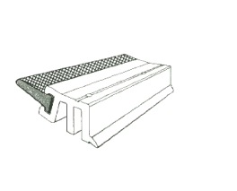
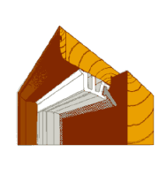
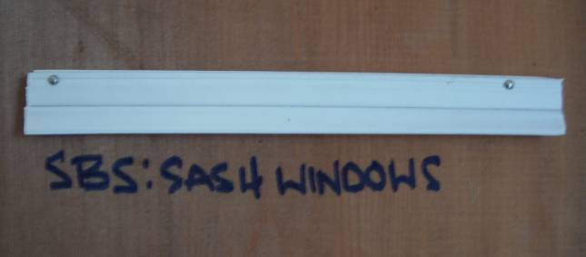
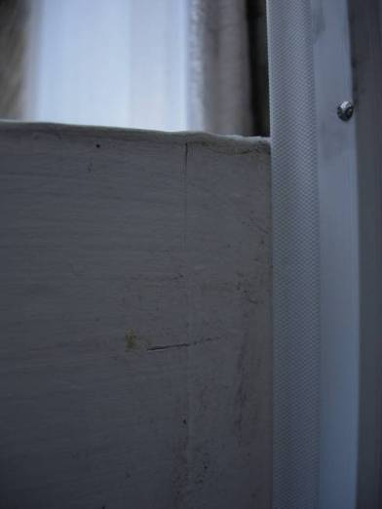
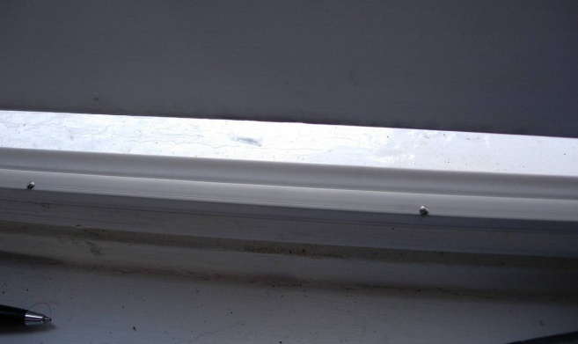
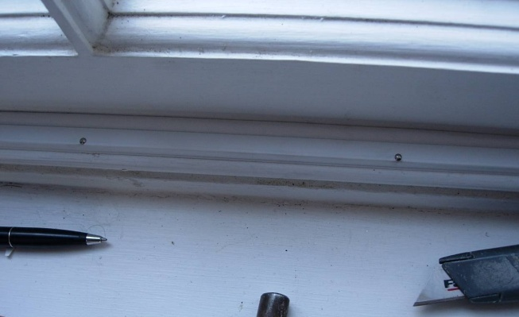
Sash Windows - Retro B strip
Retro B strip - For Windows and Internal Doors
Use around internal doors and windows, including sash and casement windows
They can also be used around many loft hatches
Easy to fit and look neat and unobtrusive
Apply around the bottom and inside of a sash window
Where possible apply the strips around the top sash from the outside of the window
The strips are nailed around the window frame so it’s easy to open and close the window
First measure and cut the strips for each side, then and cut and fit. Once the sides are in place, measure and cut the bottom horizontal piece and then fit.
If access to the upper outside part of the sash window is prohibitive try to attach either a Retro B or 21B strip to the surrounding window frame of the upper sash (rather than the actual window)
With window open
With window closed-forms seal

Slide 7
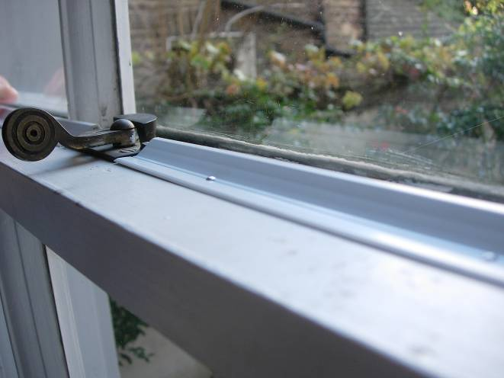
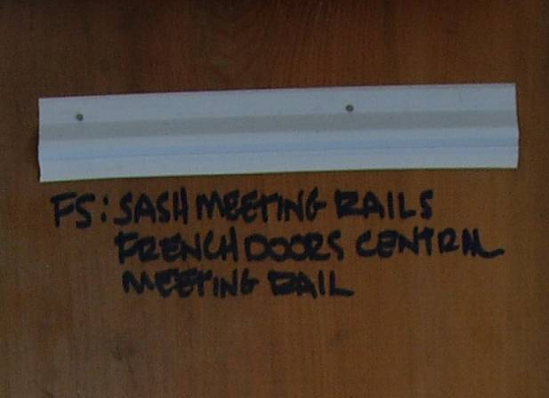
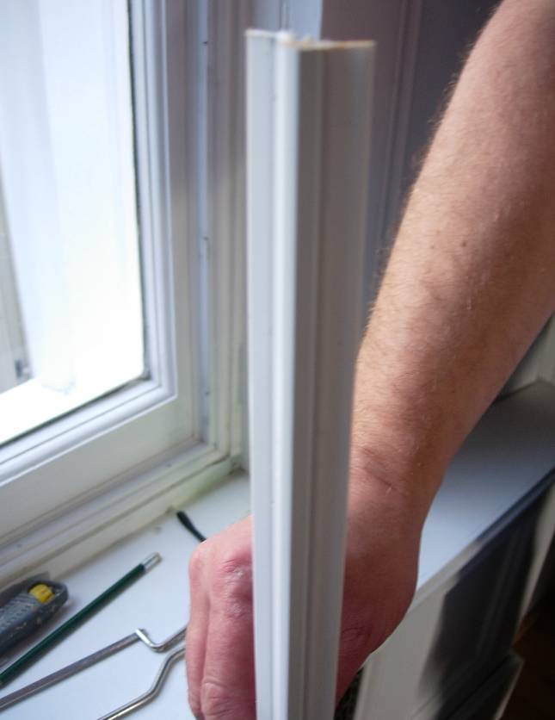
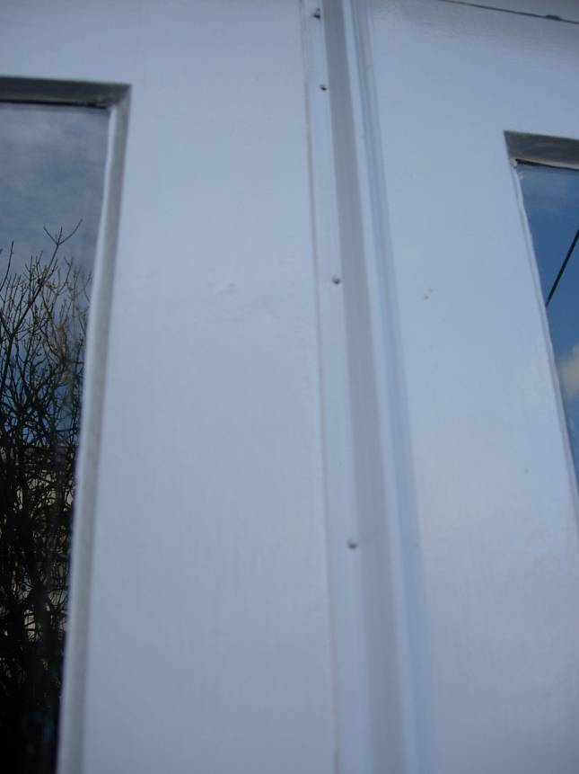
Sash meeting rails/ French doors - FS strip
FS strip – Meeting rails on sash windows, centre rails on French doors
These cover the horizontal gap where the two sashes meet in the middle of the window
These can be also used on French doors where the two doors meet as shown below
If the FS strip cannot cover the gap because the two sashes do not meet on the same level then try using a self-adhesive P-strip or Zero gap strip stuck on the back of the meeting rail of the bottom of the sash
This will help to prevent rattling and unwanted draughts blowing through the centre of the window
7

Slide 8
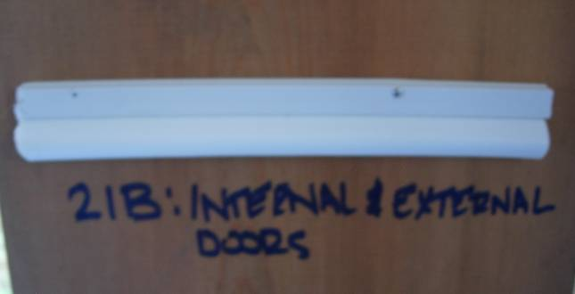
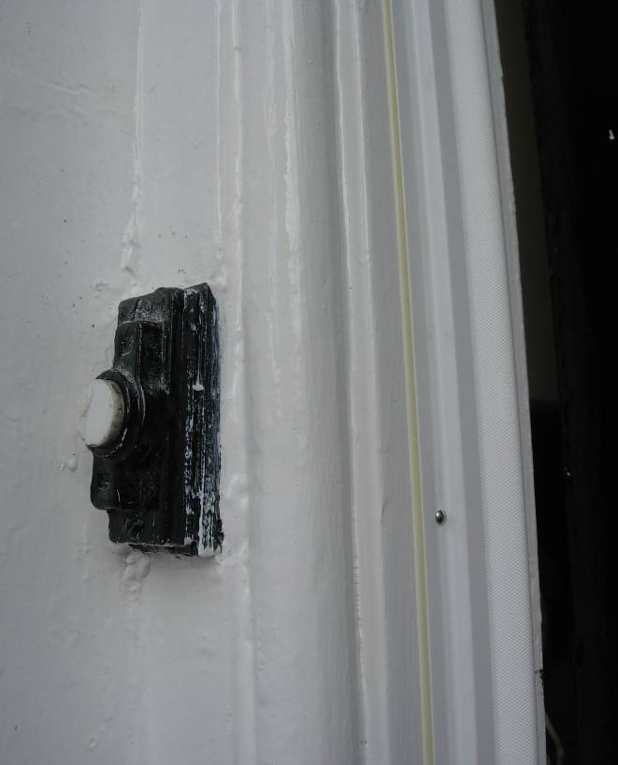
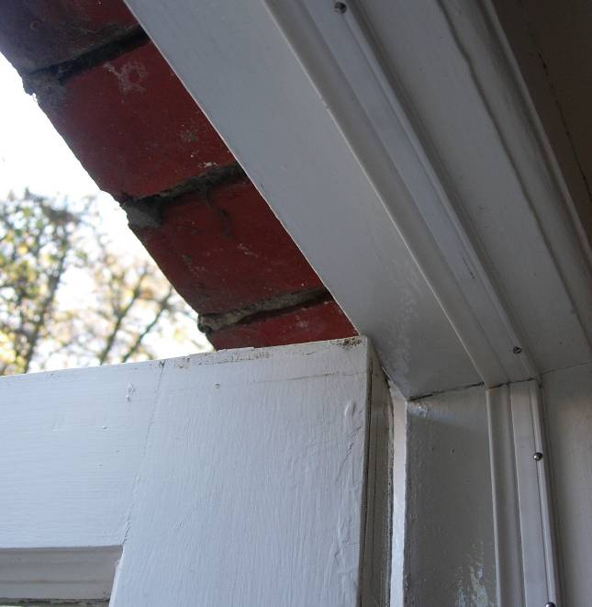
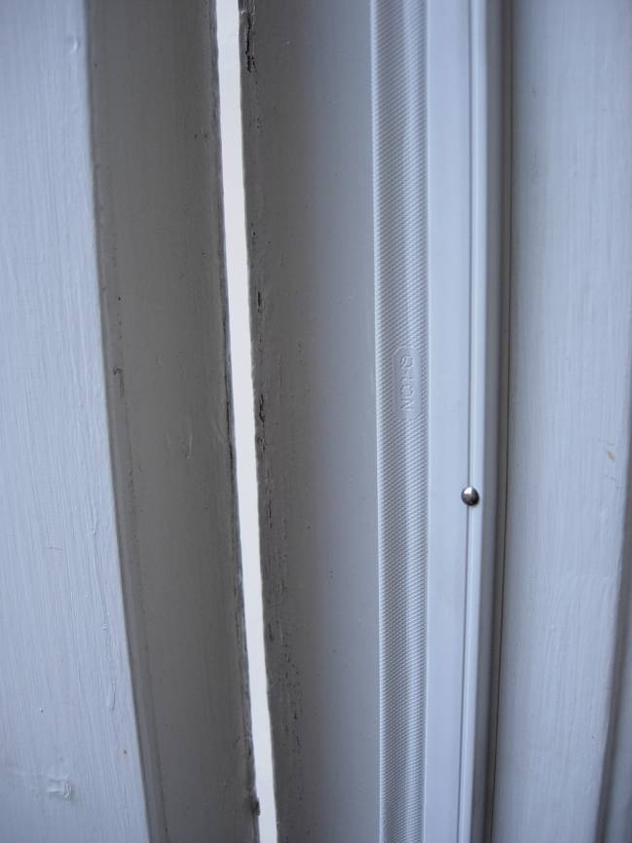
Outside doors – 21 B strip
21 B strip – For external doors and larger gaps
Use for External doors but can also be used internally
The strips are applied in the same fashion as SBS strips but have more expansion capability and can cover larger gaps often needed for external doors
Fix in place with door shut and fully locked
Apply the strips to the top of the door frame first and then the vertical sides
Ensure nominal compression of the seal is 3mm, and that there is a visual movement of the seal when the door is opened and closed
You may wish to mitre the strips in the corners at a 45 degree angle
These strips can be used to cover slightly larger gaps
Their design makes them easier to compress so are less likely to make doors difficult to close
These strips have more expansion capability-useful as the gaps around the outside doors tend to expand and contract more
They can be used to cover slightly larger gaps (also on sash windows)

Slide 9
Installation Instructions
Cut with garden pruners (anvil blades give the best cut- we have not been able to find a local supplier of these but they can be bought from www.birstall.co.uk) or a junior hacksaw.
Cut each strip generously to start – maybe 1 cm too long, then check carefully before trimming to exact size required.
Cut each strip and fit it and then cut the next one and so on.
Use the supplied 20/25mm stainless nails which are rustproof and have small heads.
Use all the pre-formed nail holes, however at the end of the strips, depending on how you have cut them, you may need to make an additional nail hole in the strip. This should be done approximately 1” from the end of the strip, into the same small groove where the pre-drilled holes are positioned – this is to minimize any risk of splitting the casing.
Don’t drive the nails all the way in at first - just half way - this will allow fine adjustment of pressure and position later.
The plastic flexible trim should push up against the closed window or door with gentle pressure to seal any gap but not so hard that they prevent the window closing or cause too much friction on the sliding sash.
With each strip in place the nails can be driven home and their angle altered slightly during hammering to increase or decrease this pressure to ensure contact with the window/door. Fully drive home nails perpendicular to surface but do not over pressurize (or this may drive the nail through the PVC carrier).

Slide 10
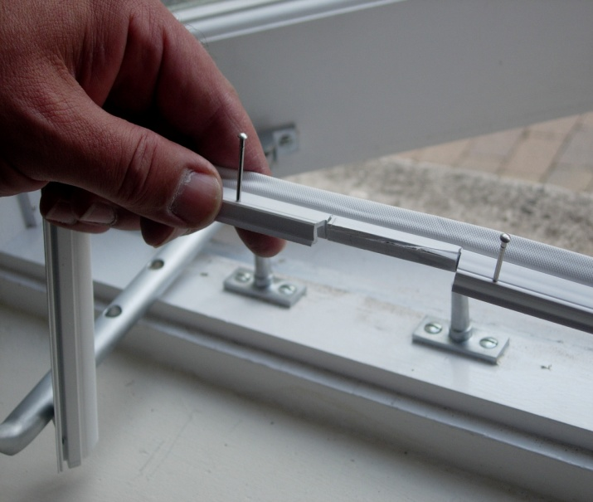
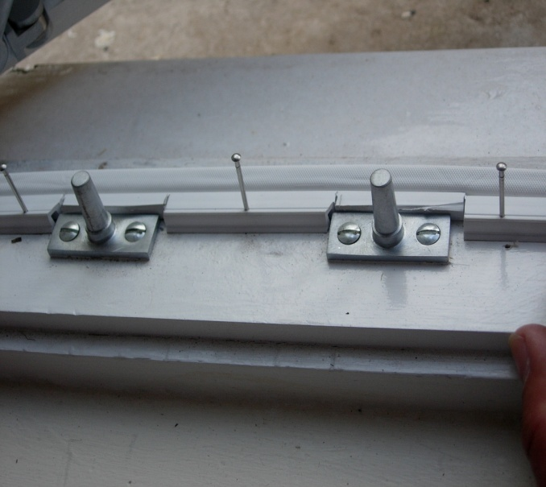
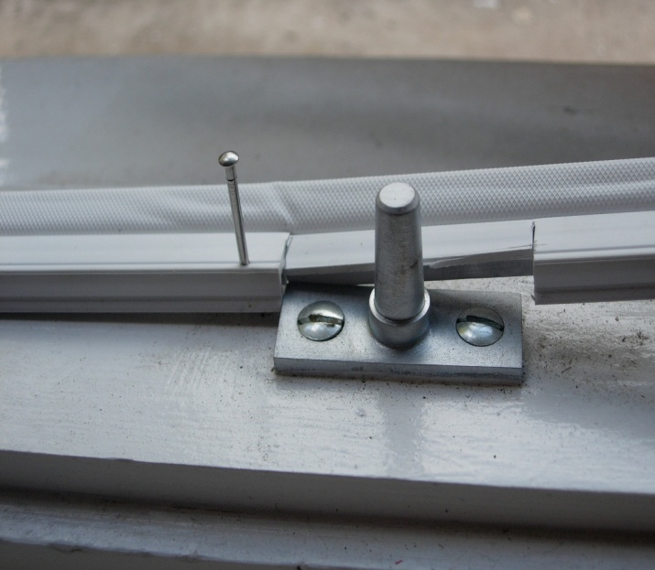
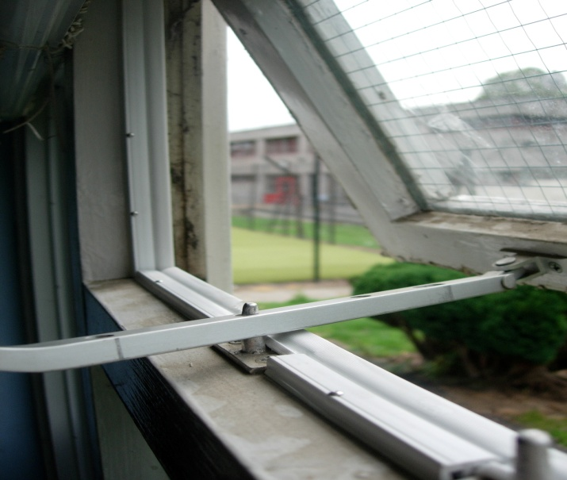
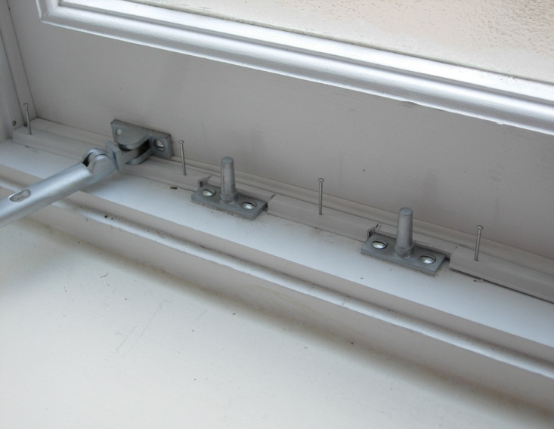
Examples of fitting Retro B strips to casement windows

Slide 11
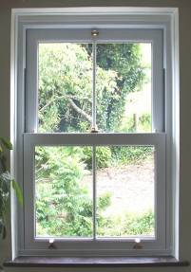
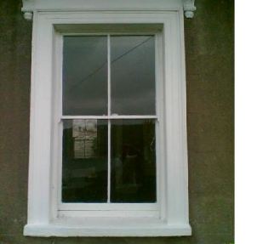
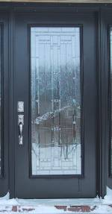
MEASURING YOUR DOORS AND WINDOWS FOR DRAUGHT STRIPPING.
The strips we are using are difficult to find in shops. At the end of the workshop you will be able to buy the strips you need. You will be offered some strips for free (£20 worth for hosts / £10 worth for participants). The strips need to be installed on the frame of the door or window where the door or window closes.
Outside sash window
Inside sash window
Retro B
FS strip
width
height
width
height
21B strip

Slide 12
Record your measurements
(with examples. Print several sheets if necessary)
Measure each window and each door and decide which strip you’ll be using, then record your measurements in the table below.
Convert your measurements into the full amount of strips needed for each window and each door. Bear in mind that each strip is 2.05 metres long.
There will be some pieces of strip leftover – they can often be used for other windows or smaller gaps etc..
NB. if you cannot access the top part of the sash window safely from the outside, just measure the bottom part of the sash and ignore measuring the top.
We can help you with this during the workshop.
Item | Width | Height | Retro B strip |  | FS strip |  | 21B strip
/ | / | / | length | quantity | length | quantity | length | quantity
E.g. Window 1 | 110 cm | 90 cm | 290 cm | 2 | 110 cm | 1 | / | /
Window
Window
Window
Window
Window
Window
Window
Window
E.g. Door 1 | 90 cm | 220 cm | / | / | / | / | 530 cm | 3
Door
E.g. French door | 114 cm | 200 cm | / | / | 200 cm | 1 | 514 cm | 3
French door
TOTALS | / | / | / |  | / |  | /

Slide 13
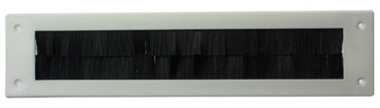
Letter Box and Under Door Brushes
LETTERBOX BRUSH
Includes 4 screws
Advice: position first before attaching and check that letters/papers can be posted easily and that the flap won’t stick in brushes.
STRAIGHT DOOR BRUSH - CAN BE USED ON CARPETED FLOORS
Contents: 2 Straight CLIPS - L & R 5 screws
Instructions: Cut plastic carrier from the end without a screw hole to fit the door width. Cut the brush strip to length & crimp end with pliers.
Use clip as a template to mark and drill a hole at the cut end to match the other end. Fix strip & brush to door with clips/screws.

Slide 14

Double Glazing Film
DOUBLE GLAZING FILM
An economical alternative to double glazing.
Easy to fit. You only need scissors, a sharp knife and a hairdryer.
Similar double glazing film can be bought from Harris Hardware at 92 High Street,,Totnes. Tel. 01803 863276

Slide 15
MagneGlaze-added glazing
Additional Products
MagneGlaze Secondary Glazing System
The MagneGlaze magnetic system is an attractive self-adhesive secondary glazing system which attaches to the perimeter of the 2mm acrylic sheet and then to the window frame. The glazing can be removed easily by pulling the magnetic strip, attached to the acrylic, away from the metal strip attached to the window. To replace, simply align the strips and the magnetism pulls the sheet into place.
Is it suitable for my window?
The surround of the window needs to be flat and at least 15mm wide.
The only other limit to the magnetic system is that it will only hold up to about 20 square feet of 2mm acrylic. Larger areas will need additional clips or the use of 3mm acrylic. If the windiw frame is suitable it may be possible to stabilize the acrylic with a magnetic strip in the middle of the window.
Advantages
MagneGlaze not only cuts out drafts but also provides some double glazing heat saving and increases sound insulation. Simple to fit – but measure the window frame carefully. It can be easily removed and stored as required.
Disadvantages
Care is required when cleaning or when storing to prevent the acrylic getting scratched. Need to be stored during the Summer.
Cheaper secondary glazing options available through he DIY route –see below.
Do I still need to add draught strips to the sash window?
If the sash window is very draughty then it is advisable to reduce the draughts with draught stripping as well as using MagneGlaze secondary glazing.
Suppliers: Nigel’s Eco-store- www.nigelsecostore.com
or
MagneGlaze-
www.magneglaze.co.uk
For a cheaper DIY alternative you can buy acrylic sheets from Abbey Plastics – www.abbeyplasticssouthwest.co.uk Tel.01626 337755 -in Newton Abbot and the magnetic steel strips from RS 0nline- uk.rs-online.com ,but see also DIY secondary glazing on page 17

Slide 16
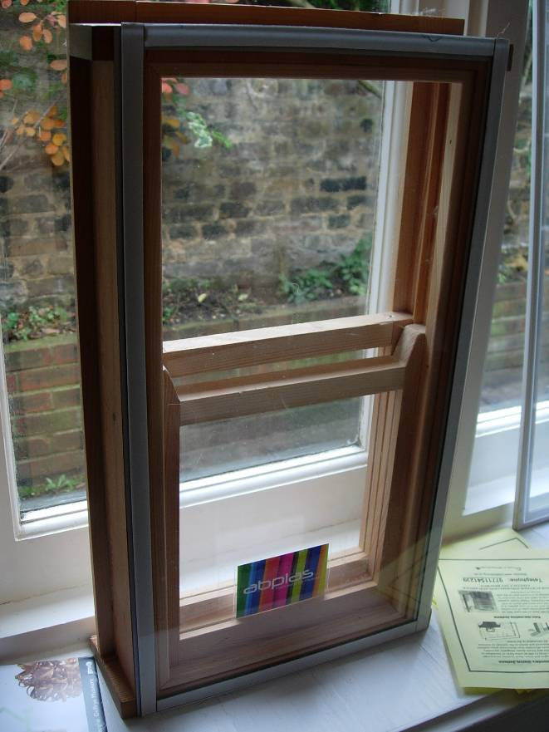
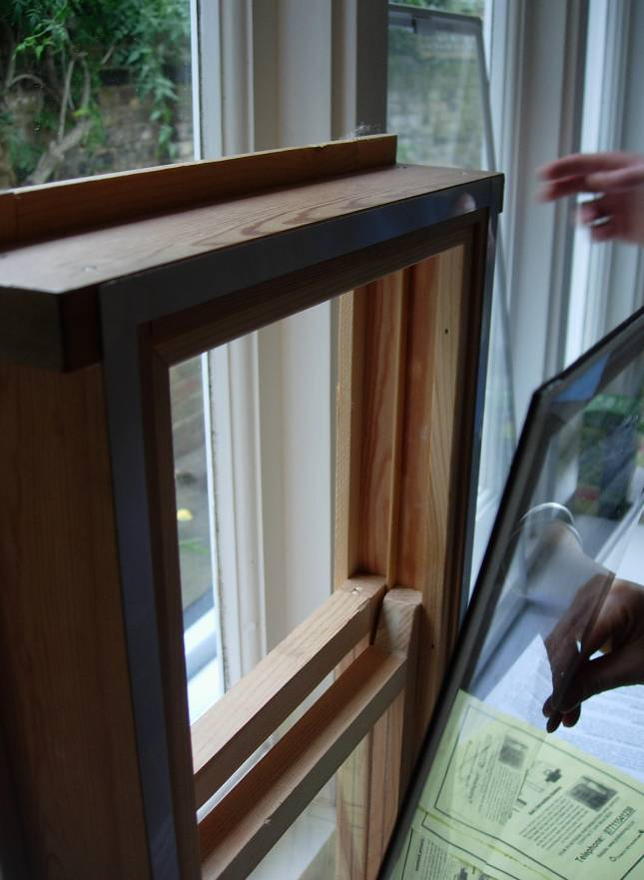
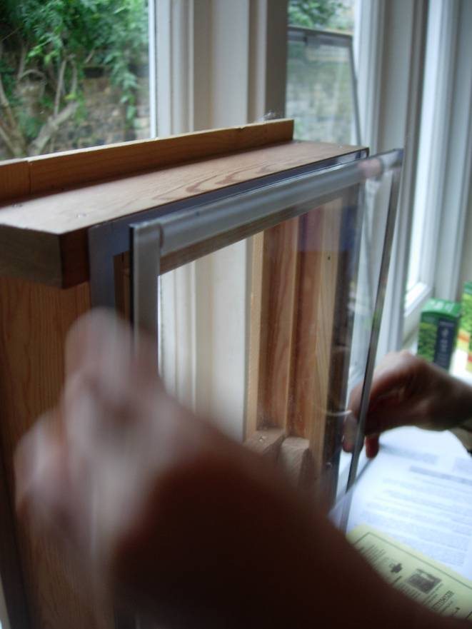
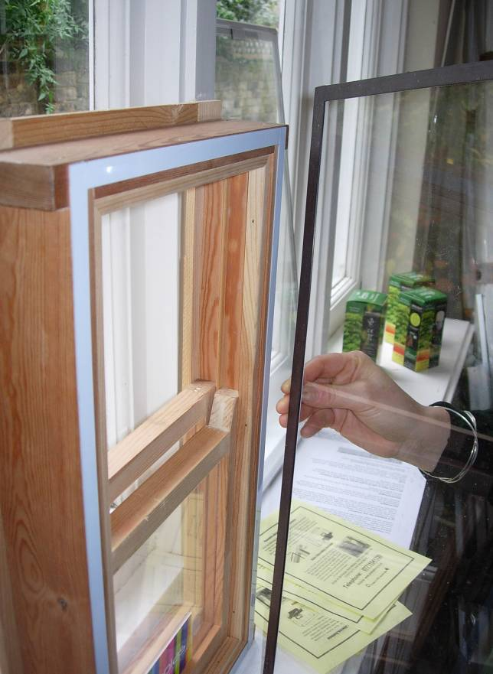
Magnaglaze-added glazing
16

Slide 17
DIY Secondary Glazing
Why DIY secondary glazing for sash windows?
Secondary glazing will reduce draughts and make you warmer, can significantly reduce heating costs and help minimise noise.
With old sash windows, more heat is typically lost from the draughts around sash windows, than across the glazing itself¹, so like double glazing, well-fitted secondary glazing can almost eliminate draughts, but at a fraction of the cost.
It can be done very discreetly without any damage to the original window.
With high quality acrylic or polycarbonate there are no scratches or marks.
Planning permission is not usually required for the installation of the secondary glazing described in this leaflet including to those homes within Conservation Areas. For listed buildings and it is important to consult your local planning authority’s Conservation Officer for advice before installing secondary glazing. Listed Building Consent may be required in some cases.
Heat loss
In the MASHFFF project in Ashburton was 10 homes had an air pressure test. By sucking air out of the house with a powerful fan it is possible to measure the leakiness and precisely locate the draughts.
For all of the five older properties that were audited, it was found that around a third of heat is lost through draughts. In comparison a typical UK home only loses around 15% through draughts².
A local solution
One household in the Ashburton project had developed their own simple yet highly effective DIY glazing for approximately £60 per window (you’ll have to pay many times this for professionally installed secondary units) and this is method that is shown here. When the home was pressure tested there was no discernible draught and what’s more you could barely tell that the secondary glazing was there, as it was so discreet. Installing the glazing requires relatively basic DIY skills.

Slide 18
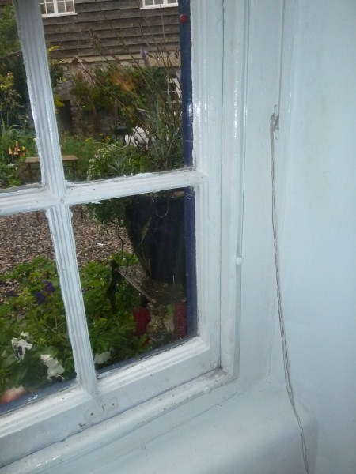
Tools and materials needed:
Drill
3mm drill bit (preferably a bit blunt to
minimise cracking)
Posi-drive screwdriver
Scissors
Tape
Permanent marker pen (to mark the film covering the plastic)
Acrylic or polycarbonate sheeting (4, 5 or 6mm) the bigger the window the thicker the plastic you’ll need
Screw cover caps 6-8mm plastic white
¾ inch or 19mm plasterboard screws (less likely to split wood than normal screws) - enough for 30cm spacing around window edges
P-section EPDM rubber draught-proofing strip (not foam as it degrades) you will need enough to surround the edge of each window
beading
Preparing and installing your glazing
Step 1
Measure all window dimensions, along top, bottom, left and right. The secondary glazing will screw onto the beading as shown in the picture above, which is relatively easy to replace and avoids drilling into the original sash box. Check the window has right angle corners by measuring the diagonals to check they are the same (many older windows are a bit wonky)! Creating a paper template is strongly recommended before paying for the plastic to be cut. You want the edges of the window to fit over to the outside edge of the wooden beading – and you will screw the plastic sheet into the beading.
Please note that Listed Building Consent may be required if the bead is to be replaced or substantially altered. Consult your local planning authority’s Conservation Officer for advice prior to any work.
Step 2
Decide whether you want Acrylic (considerably cheaper and not quite so light) or Polycarbonate (stronger and clearer but more expensive). Both have similar thermal properties.
Find someone to provide your plastic (our example house used Abbey Plastics in Newton Abbot – competitive prices and good quality plastic with no scratches. They can cut it exactly to size, even if you don’t have right angles. You may want to search around for other providers).

Slide 19
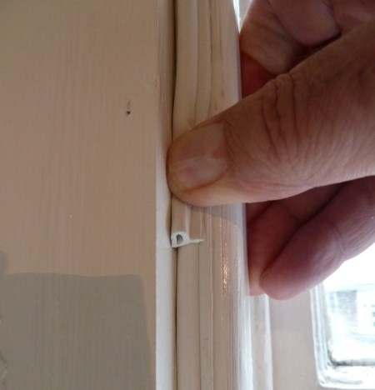
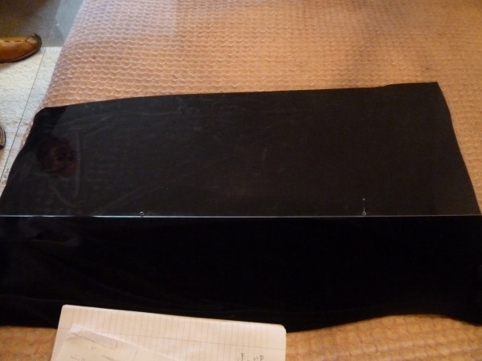
Step 3
Once you have bought the plastic, offer it up to the frame to check that it fits against beading. Clean the beading with spirits and also the window that you are about to cover.
Step 4
Cut lengths of P strip as shown in picture to the left (if the windows are uneven you can build up two layers if necessary to make a better fit). The fat bit of the P needs to fit against the outside edge of the beading, fitting over the gap between the window and the sash box.
100mm
300mm max
Step 5
Measure out the hole’s centres and mark each with a cross. These should be around 100mm from the corners to prevent the corner breaking off. The holes should be half the width of the beading in from the edge. E.g. if the beading is 3cm wide, make the holes 1.5cm from the edge. Measure out holes spaced around the edge of the plastic, choose a spacing to suit, up to 300mm between holes. When all are marked, drill them with a scrap of wood behind, using the 3mm drill bit. It is worth drilling the holes for the top into the beading first and then attaching the screws. The remaining screws can then be drilled directly into the beading with the glazing in place.
100mm
1mm hole at end of crack
drill hole
Step 6
If a hole cracks, drill a 1mm hole at the end of the crack to provide stress relief and stop the crack spreading further (see picture to left)

Slide 20
Step 7
Remove inner protective sheet of film (from the side that will be facing the outside). Position the sheet in the window. Fit the top centre screw first, screwing through the screw cap. If using a power screwdriver use a slow speed setting, otherwise tighten loosely. Next, secure bottom left and right screws, before remaining screws alternating left and right. This ensures that the force is distributed evenly and helps prevent damage.
OUTSIDE
sliding sash
beading
sash box
P-section rubber
secondary glazing
Step 8
Close the caps and pull off the outer protective film. This will tear away from around screws, but this doesn’t matter.
Stand back and admire your window!
screw cover cap
INSIDE
Condensation
Condensation occurs as a result of a combination of inadequate heat, inadequate ventilation and excess moisture. Many people assume that their damp problems are due to inadequate ventilation and are therefore reluctant to tackle draughts, whereas the problem is often a more complex combination of poor insulation, under-heating and a failure to control moisture.
Unless your home is very cold, then fitting secondary glazing should not lead to the build up of condensation and mould. To be sure, it is worth taking all possible steps to minimise the production of moisture:
Use extractor fans when cooking or in the bath/shower, alternatively open a window briefly when creating any steam, closing the door to the rest of the house.
Keep lids on saucepans.
Ensure your home is insulated where possible in order to create a warmer home that is less susceptible to damp and cold.
Ensure that rooms prone to damp are adequately heated.
If your home is very prone to damp problems then you may want to avoid secondary glazing the kitchen and bathroom, or if severe, then avoid it altogether and first investigate the source of damp.

Slide 21
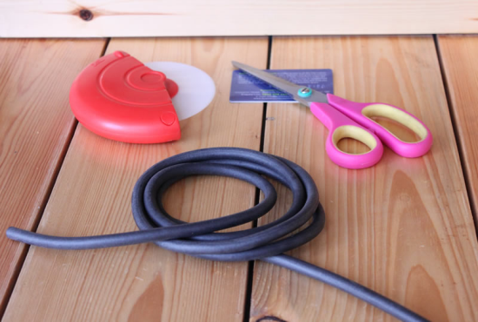
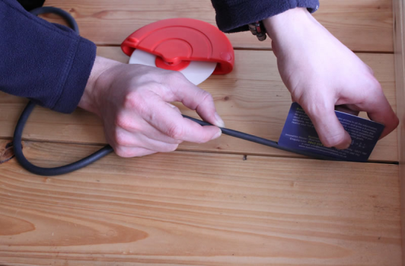
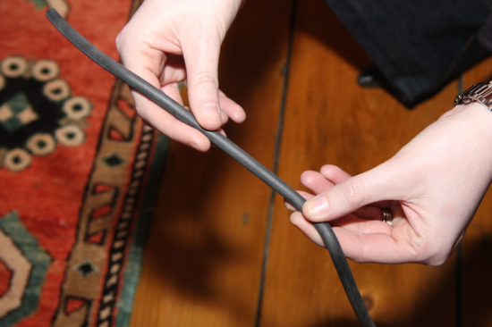
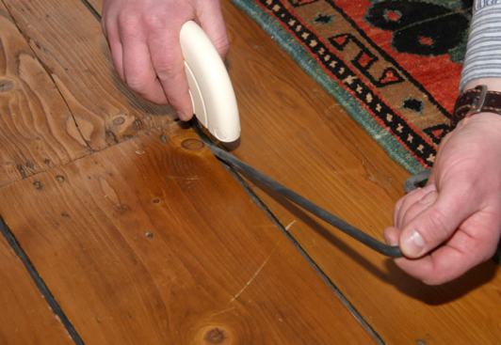
How to Fill Floorboard Gaps with
Draughtex Floorboard Insulation
DraughtEx Floorboard Filler
DraughtEx is a proven floorboard gap filler, designed to eliminate the cold draughts and improve the comfort and energy efficiency of your home.
Easy to install, DraughtEx requires no adhesives and compliments the overall finish of your floorboards. The specially formulated colour "Shadow" has been designed to mimic the natural shadows created between floorboards and is almost invisible to the naked eye.
Its flexible properties allow DraughtEx to be applied to a wide range of gaps which will be completely sealed. The filler can also be used to seal gaps between floorboards and skirting boards. DraughtEx can be ordered with an applicator and comes in 3 sizes, small for gaps of 3mm or less, medium for gaps of 2 - 7mm and large for gaps of 6-11mm.
Energy Savings
Based on the results of research carried out by The Energy Saving Trust, it is estimated that filling floorboard gaps can save a household up to £20.00-£40.00/room/year on energy bills and reduce its CO2 contribution by around 110kg.
www.draughtex.co.uk
Help and Advice - Freephone 0800 088 7311

Slide 22
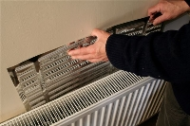
Radiator Panels
Reflective Radiator Panels
What size are the panels?
The panels are approximately 600mm
wide by 520 mm high
Does the radiator have to be removed?
In almost every case the panel can easily
be fitted with the radiator in place.
Will the panel be visible?
Not necessarily. The panels can easily be fitted out of the line of sight.
Do the panels only fit certain sizes of radiator?
No, the panels can be easily cut and overlapped to fit any size of radiator.
How easy is to fit the panel?
Easy to fit!
A simple operation without the need to remove the radiators. The panels are easily cut to size, and fitted to the wall behind the radiators using best quality heat resistant double-sided tape for fixing. The only tools needed are scissors and a bamboo cane or wooden spoon handle to reach the awkward corners. Use small strips of double-sided good quality sticky tape.
How does it work?
A lot of energy from radiators is wasted heating the walls behind them rather than heating the air in the room. The reflective, insulating panels change this, forcing more of the heat energy available into the room space and returning unused heat back into the radiator to reduce boiler burn times. The radiator panel causes the naturally rising hot air behind the radiator to spin, creating a series of vortices which rise at increasingly higher speeds, ultimately spinning the warm air far into the room.
How do you save money?
Reducing the primary heat loss from the radiator (through the wall) makes your heating system more efficient; allowing your boiler to burn less fuel to achieve the same room space heating. Simply put, your heating bill is reduced because you need less heat to warm the room to comfortable levels.
There are several useful You Tube videos with instructions on fitting the panels e.g. http://www.youtube.com/watch?v=aaXlF6T39lM
To order please use order form on page 23
.

Slide 23
Order form 2014
Customer Name: |  | E-mail
 |  | Tel:
Application | Item Name | Price | Unit | Qty Reqd. | Value £
Sash windows – edges Internal doors Loft hatches | Retro B strip | £1.50 | 2.05 metre strip
Sash meeting rails French doors – central meeting rails | FS strip | £2.80 | 2.05 metre strip
External doors Front doors | 21B strip | £2.50 | 2.05 metre strip
Bottom of doors (door flush to flooring) | Straight Door brush | £1.50 | 914 mm brush strip
Letter Box | Letter box cover | £1.50 | Each +screws
For Gaps between sashes and other gaps | E strip | £0.80 | 1 metre
Radiator panels to keep heat inside | Reflective panel | £2.50 | 600mm x 520mm
Total value
 | Payments by cheque: To: Transition Town Totnes If you need to make arrangements to collect strips from the TTT office at 43 Fore Street, Totnes, TQ9 5HN please contact Mary Popham on 07815 799996 or marypopham@btinternet.com

Slide 24
Contact
To find out more about the Harbertonford Energy Savers project or to order draught busting products please contact Mary Popham on marypopham@btinterntet.com or 07815 799996
24

